Slide 1


Insert your
Name
Insert your Role
Insert your Organization

Slide 2

Next Generation
Recruiting

Slide 3
The Future
It is More than a Career
Little
Known
Facts
Options
for
Careers
Key Benefits

Slide 4
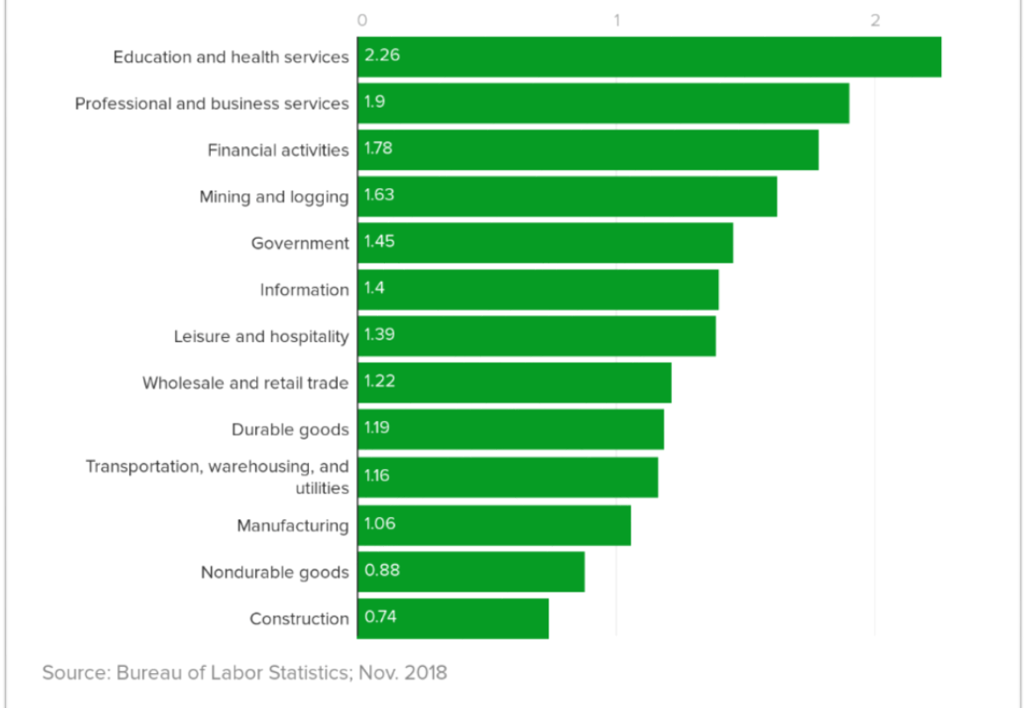
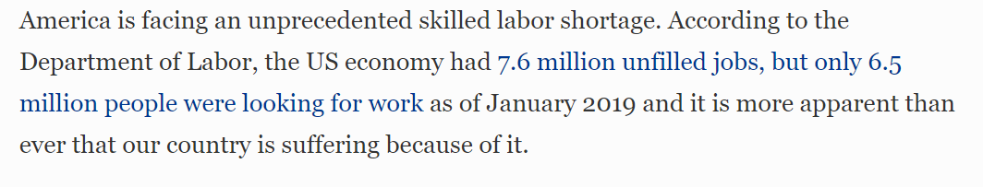
Skilled Professions
Have More Jobs Than Workers

Slide 5
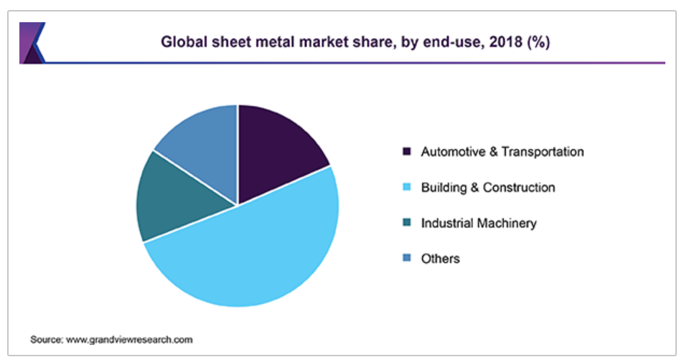
2020 Sheet Metal Industry Facts
The global sheet metal market size was valued at USD 265.0 billion in 2018 and is expected to exhibit a CAGR of 5.0% from 2019 to 2025.
Sheet metal is one of the common building materials used across construction sector for various applications.
Continuous expansion of building & construction sector is one of the key drivers for the metal market
Sheet metal is metal formed by an industrial process into thin, flat pieces.
Sheet metal is one of the fundamental forms used in metalworking, and it can be cut and bent into a variety of shapes.
Countless everyday objects are fabricated from sheet metal.

Slide 6
Top Earning Jobs
Senior piping designer | $92,600
Air traffic controller | $90,600
Elevator mechanic | $88,200
Locomotive engineer | $80,900
Boilermaker | $74,700
Lineman | $72,300
Refrigerator mechanic | $71,400
Instrument and electrician technician | $68,700
HVAC service manager | $68,000
Police sergeant | $67,800
Operating engineer | $67,700
Electrical supervisor | $66,600
Stationary engineer or boiler operator | $65,500
HVAC controls technician | $65,200
Highest paying jobs in the trades
The median pay for the 15 highest paying blue-collar jobs, based on a survey of nearly 1,000 respondents conducted between November 2016 and November 2018

Slide 7
2020 Sheet Metal Workforce Facts
Starting out
  Typically earn average of $50-$55,000 / year while training
  Trainees are Mentored up and Trained, both on the Job and in the Classroom
  Tuition Cost is $0
  Graduate with a College Degree and Zero Student Debt
  Pension, Paid Vacation, Healthcare are part of the package
After 5 years
  Workers have No Student loans and a College Degree
  Have a Skilled Professional Career in a High Demand Industry
  Will work as Project Engineer, Installer, Service Technician, Foreman or other
  Typically earn $80,000 / year on average

Slide 8
What Matters in a Career
Mattering
Community
Top motivators at work
70%
Growth
46%
money/pay
Mentoring
39%
ability to pursue their passion
Safety
challenges/excitement of the job
Purpose
SOURCE Monster Worldwide, Inc.

Slide 9
Sheet Metal Careers
We have what you want
If you want
Our Careers have
Mentorship
Clear career path
Technical skills
Leadership
Strong values
Flexible - benefits
Work life integration
Industry or functional knowledge
Apprenticeship
Apprenticeship
Tech Skills Across Diverse Fields
Foreman
Building America Great since 1888
Maternity leave
Craft is transferable
ITI Training Institute

Slide 10
SMART / SMACNA Apprentices
What attracted them?
Health
care
Retirement
benefits
Training
Wages
1st year apprentices
298
291
337
378
2nd year apprentices
229
226
232
263
3rd year apprentices
211
208
214
260
Last year apprentices
278
267
275
329
Totals
1,016
992
1,058
1,230
Percentage
68.6%
66.9%
71.3%
82.9%
1,482 respondents

Slide 11


Why Sheet Metal Workers Stay
Many Reasons
Variety of Work
Diversity
Continuing Education
Earn College Credit
Leadership Opportunities
“I don’t sit at a Desk”
"My Job is My Gym"
“Industrial Athletes Rock!”

Slide 12

Jonny Boyce: My Journey
I have worked a lot of jobs in my life. Nothing ever stuck, challenged me or utilized my full potential. I got bored very quickly and would move on, but when I got into construction everything changed.
I started on the architectural side: I got to climb on top of buildings, travel to different cities, and bounce around town. There was so much to learn and so many rewarding aspects to the job.
I went to school for graphic design since I was good with computers and loved designing things. Eventually I came to a cross road: do I stick with construction, or pursue graphic design?
I joined the Sheet Metal Workers #16 union. Soon after that I got into the apprenticeship. Through the union I took Autocad classes, learned solidworks, fusion 360, and more.
Jonny Boyce
Lead Architectural Detailer at
General Sheet Metal

Slide 13
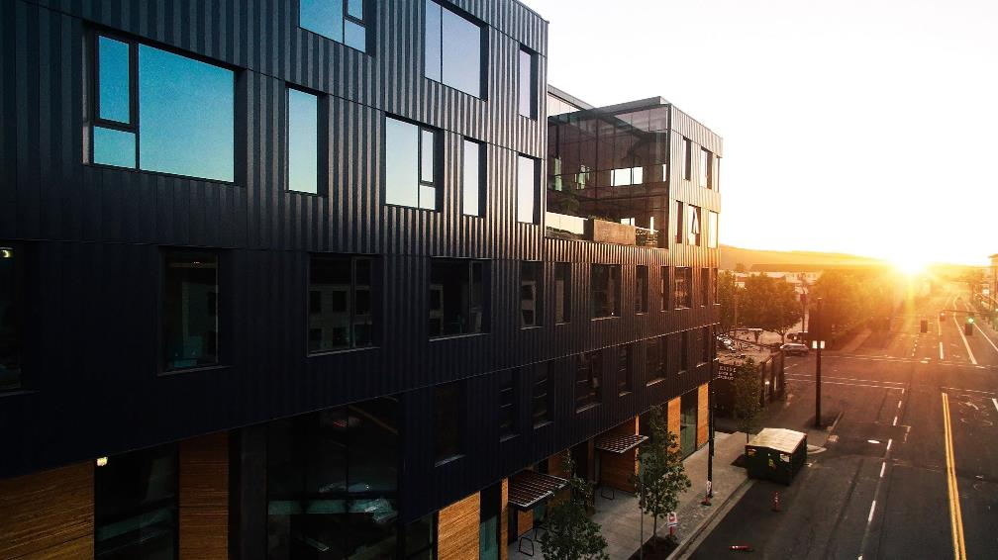
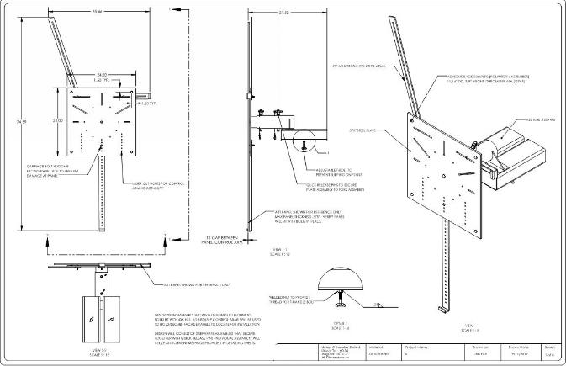
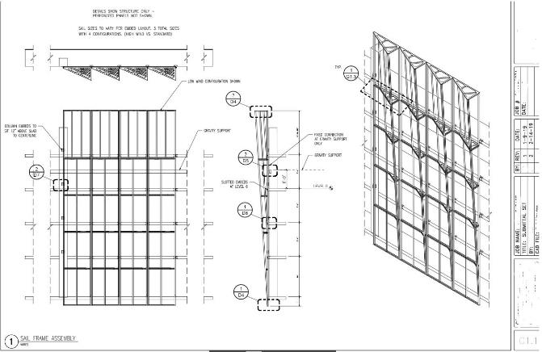
Jonny Boyce: My Journey
I get to see ideas and designs I participate in come to life. I'm constantly challenged every day. I still have so much to learn and that keeps me engaged.
I've worked on the Hyatt Hotel, OCC garage, Intel RA4/D1X, OHSU CHH, Vancouver waterfront. Portland water bureau, Portland community college, CLSB, plus 100's more smaller jobs.
I've had the opportunity to create and learn some amazing things throughout the years, and everyday I'm thankful that this is the path I chose.
Lead Architectural Detailer
As a detailer we read the plans and specs, convert the information into a buildable product, and convey that information in an easy to understand drawing. We have to account for grain direction of panels, expansion and contraction of metal, galvanic reaction/corrosion risk between dissimilar metals. Everything we do has to be extremely accurate.

Slide 14


School Counselor Toolkit
Resources you can use
We have Flyers and Posters you can share with Students They will be specific to your Area
Notes:
You can put your own logos and contact information –
These are customized

Slide 15

School Counselor Toolkit
Resources For Prospective Apprentices
Resources for Parents as well.

Slide 16
We need your help
Let’s Work Together
The future of this industry is in our hands
Your Name
Thank
Organization
000-111-2222
Your.email@goeshere.com
you
Notes:
Star on the chair – you can start today!

